Slide 1
Shared Memory (OpenMP) and Message-Passing (MPI/PVM) Models: Dynamic Process Creation

Slide 2
Parallel computing models allow multiple processes to execute concurrently and communicate with each other.
Two widely used models for parallel programming are Shared Memory (OpenMP) and Message-Passing (MPI/PVM).

Slide 3
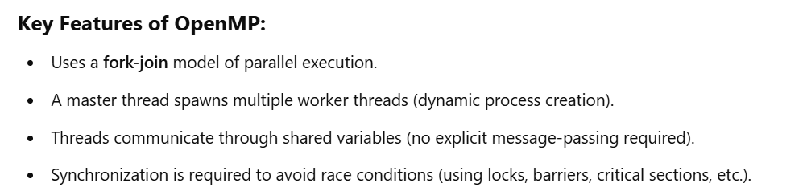
Shared Memory Model (OpenMP)

Slide 4
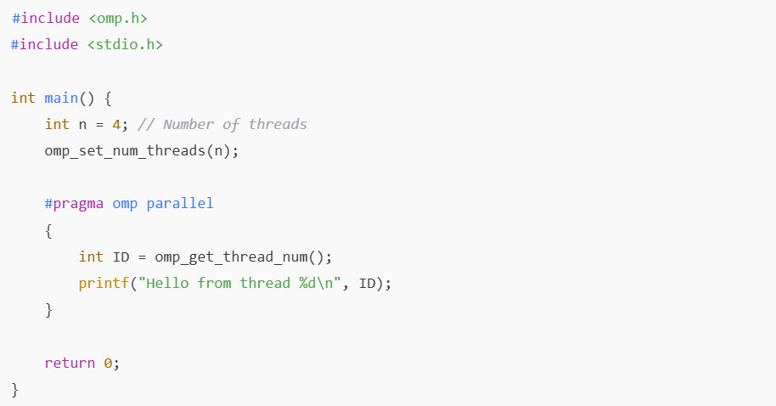

Dynamic Process Creation in OpenMP

Slide 5
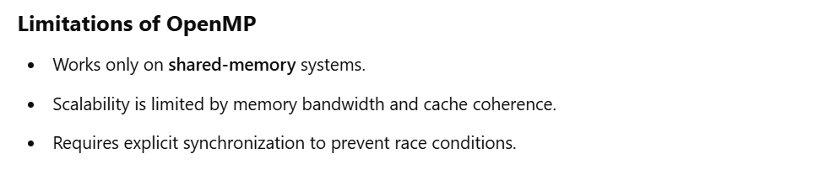

Slide 6
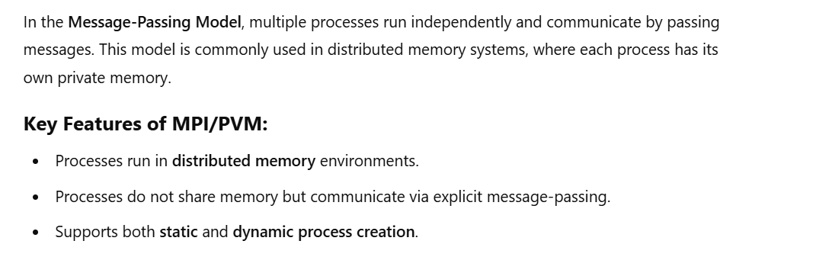
Message-Passing Model (MPI/PVM)

Slide 7

Dynamic Process Creation in MPI

Slide 8
#include <mpi.h>
#include <stdio.h>
int main(int argc, char *argv[]) {
MPI_Init(&argc, &argv);
int world_size, world_rank;
MPI_Comm_size(MPI_COMM_WORLD, &world_size);
MPI_Comm_rank(MPI_COMM_WORLD, &world_rank);
if (world_rank == 0) {
// Master process dynamically spawns worker processes
MPI_Comm inter_comm;
MPI_Comm_spawn("worker", MPI_ARGV_NULL, 2, MPI_INFO_NULL, 0, MPI_COMM_WORLD, &inter_comm, MPI_ERRCODES_IGNORE);
}
printf("Process %d out of %d says hello!\n", world_rank, world_size);
MPI_Finalize();
return 0;
}

Slide 9
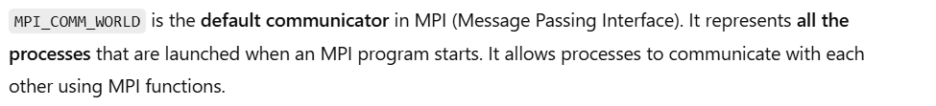
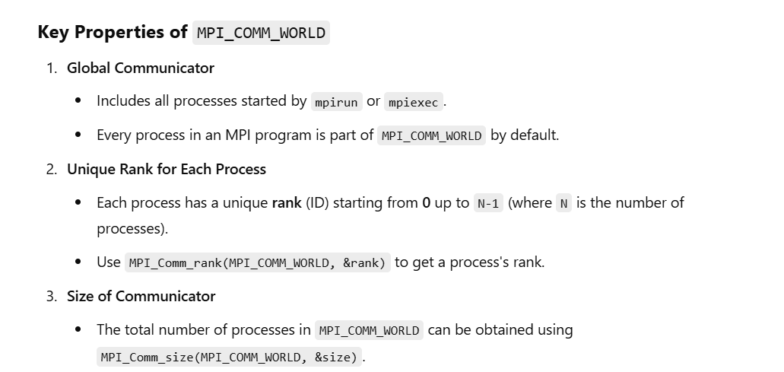

Slide 10
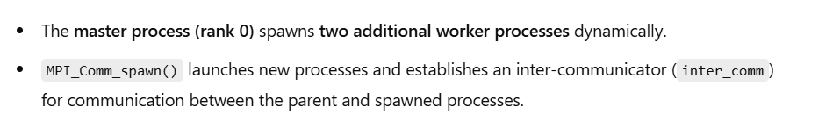

Slide 11
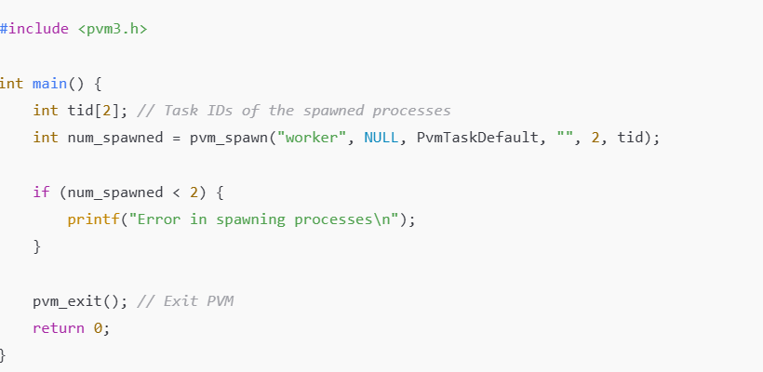
Dynamic Process Creation in PVM

Slide 12
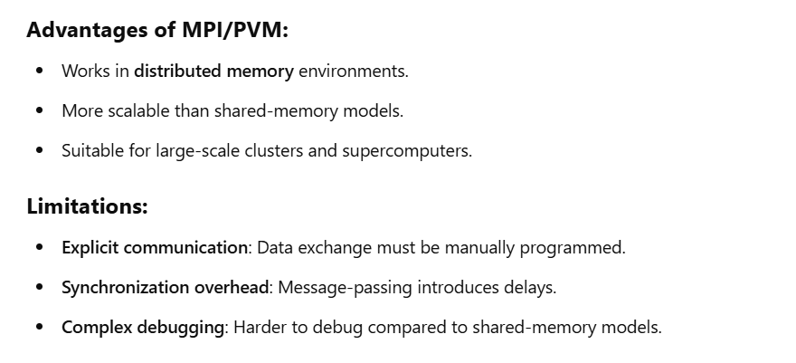

Slide 13
